Slide 1
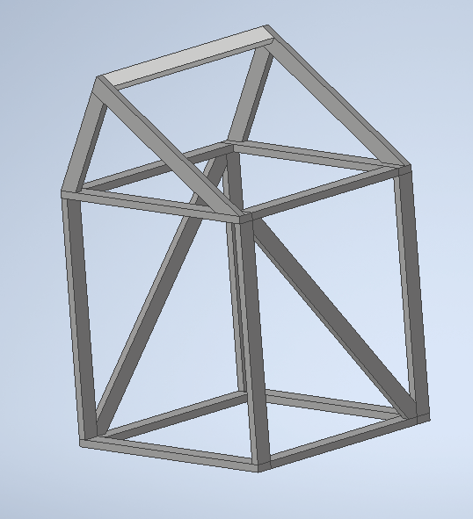
Back Leg x2
9.5 2x4x8

Slide 2
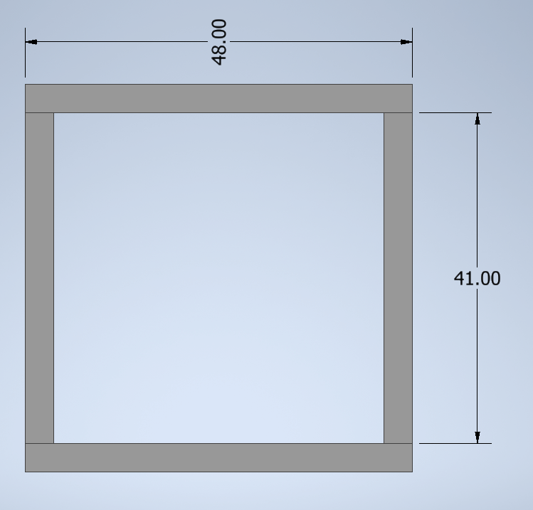
(2) 2x4x8
(2) 4’
(2) 3’5”

Slide 3
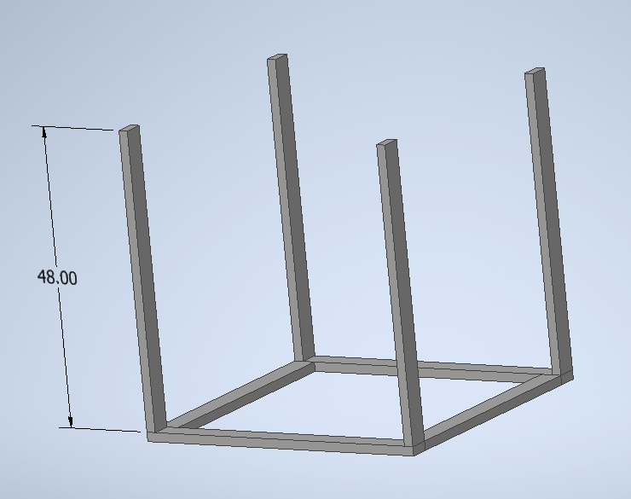
(2) 2x4x8
(4) 4’

Slide 4
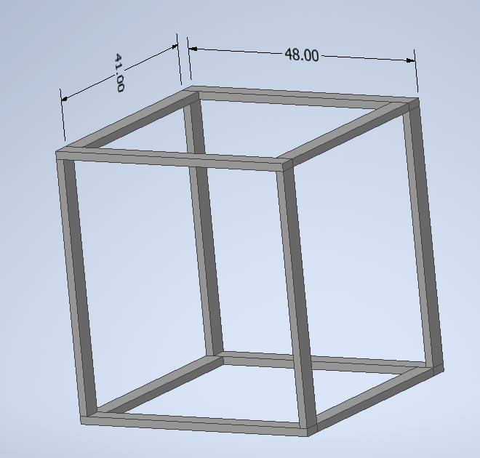
(2) 2x4x8
(2) 4’
(2) 3’5”

Slide 5
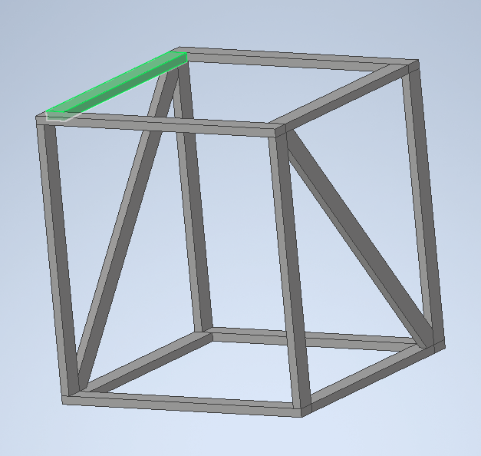
(2) 2x4x8
(2) slants
  Save excess for top slants

Slide 6
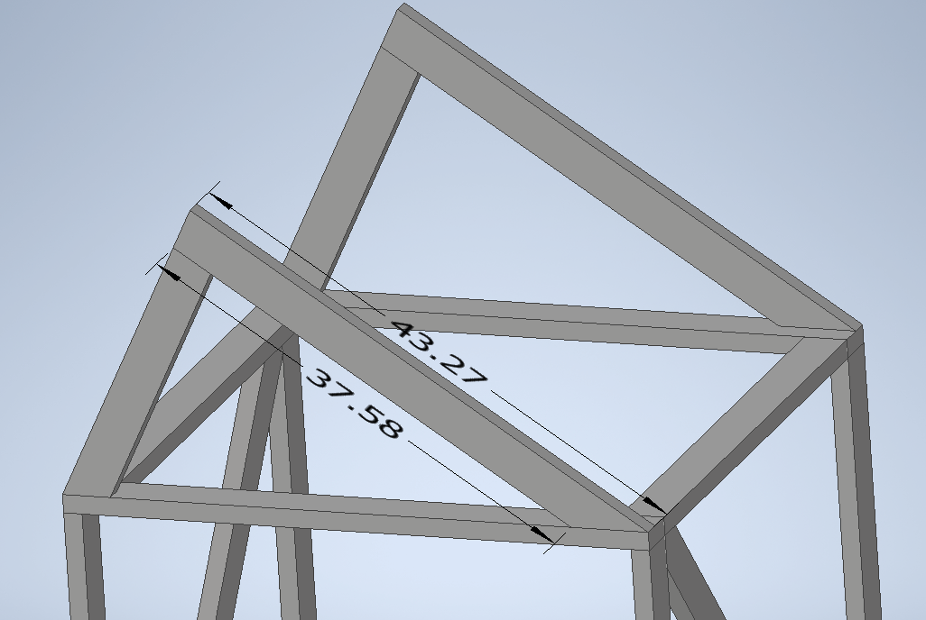
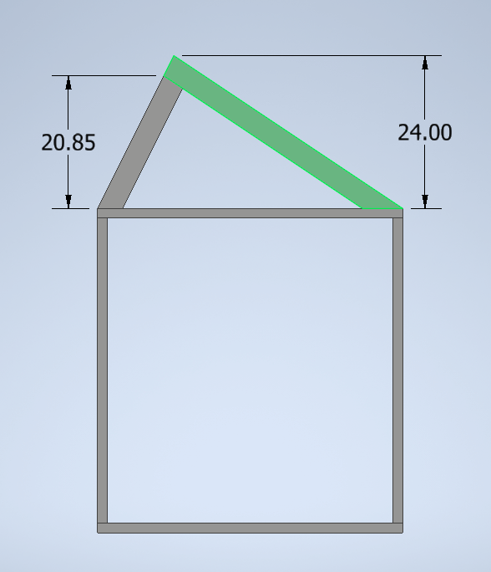
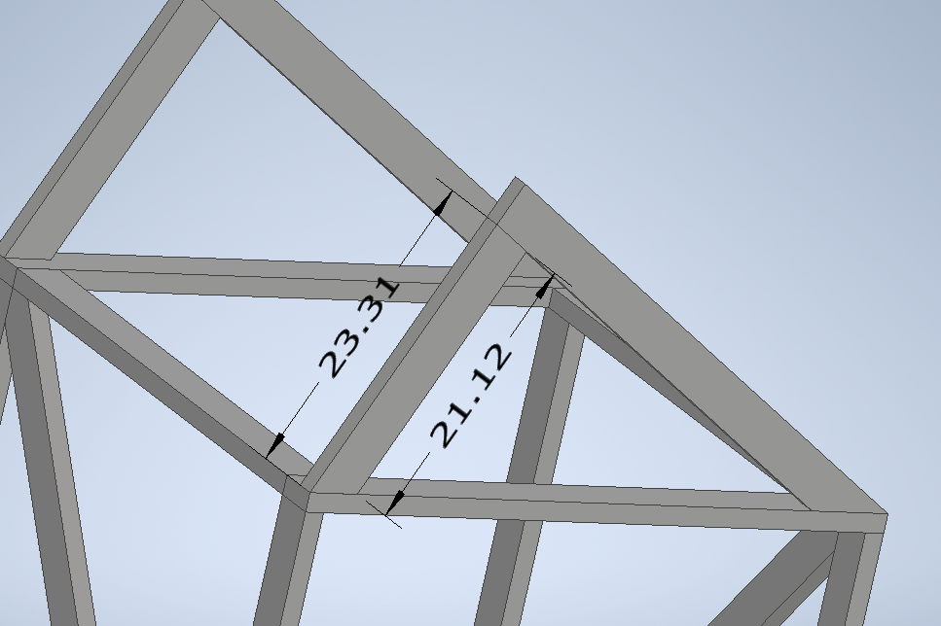
(1) 2x4x8
(2) long slants
(2) Leftover from inside slants
(2) short slants

Slide 7
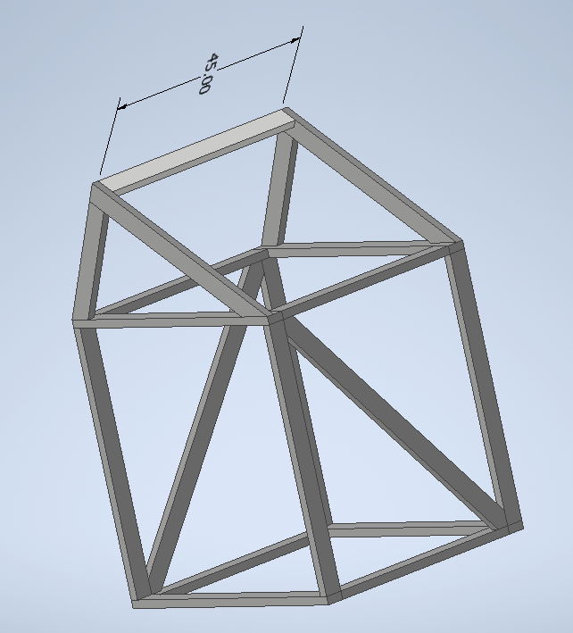
(0.5) 2x4x8
(1) 3’9”
  Save other half for second back leg

